Slide 1
CS246: Evaluating Ranking Model
Junghoo “John” Cho
UCLA

Slide 2
“Bag of Words” Assumption
Q: What is a user looking for using the query “Boston University”?
Q: Given our bag of words assumption, will the page be ranked higher than others?
  Q: Is there any way to get around this problem?

Slide 3
Phrase Queries
Find documents with “Boston University” exactly in this sequence
  Q: How can we support this query?
Two approaches
  Biword index (more generally, “n-gram index” = shingles)
  Positional index
Q: Pros and cons of each approach?
Rule of thumb: x2 – x4 size increase for positional index compared to document id only

Slide 4
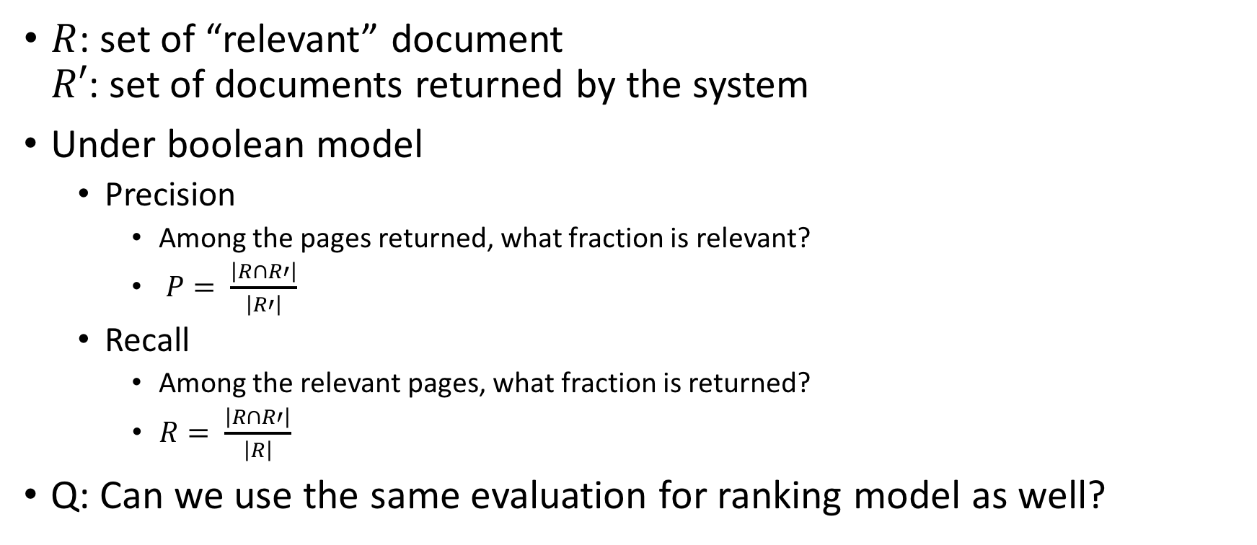
Evaluation of Ranking Model
$R$: set of “relevant” document
$R′$: set of documents returned by the system
Under boolean model
  Precision
    Among the pages returned, what fraction is relevant?
    $P= \frac{\left|R∩R′\right|}{\left|R′\right|}$
  Recall
    Among the relevant pages, what fraction is returned?
    $R= \frac{\left|R∩R′\right|}{\left|R\right|}$
Q: Can we use the same evaluation for ranking model as well?

Slide 5
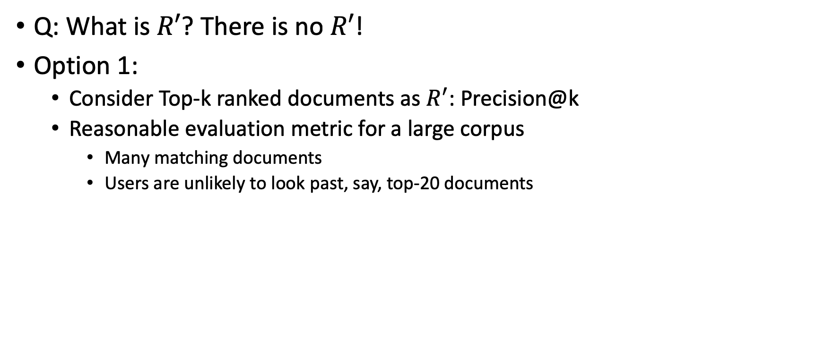
Evaluation of Ranking Model
Q: What is $R′$? There is no $R′$!
Option 1:
  Consider Top-k ranked documents as $R^{′}$: Precision@k
  Reasonable evaluation metric for a large corpus
    Many matching documents
    Users are unlikely to look past, say, top-20 documents

Slide 6
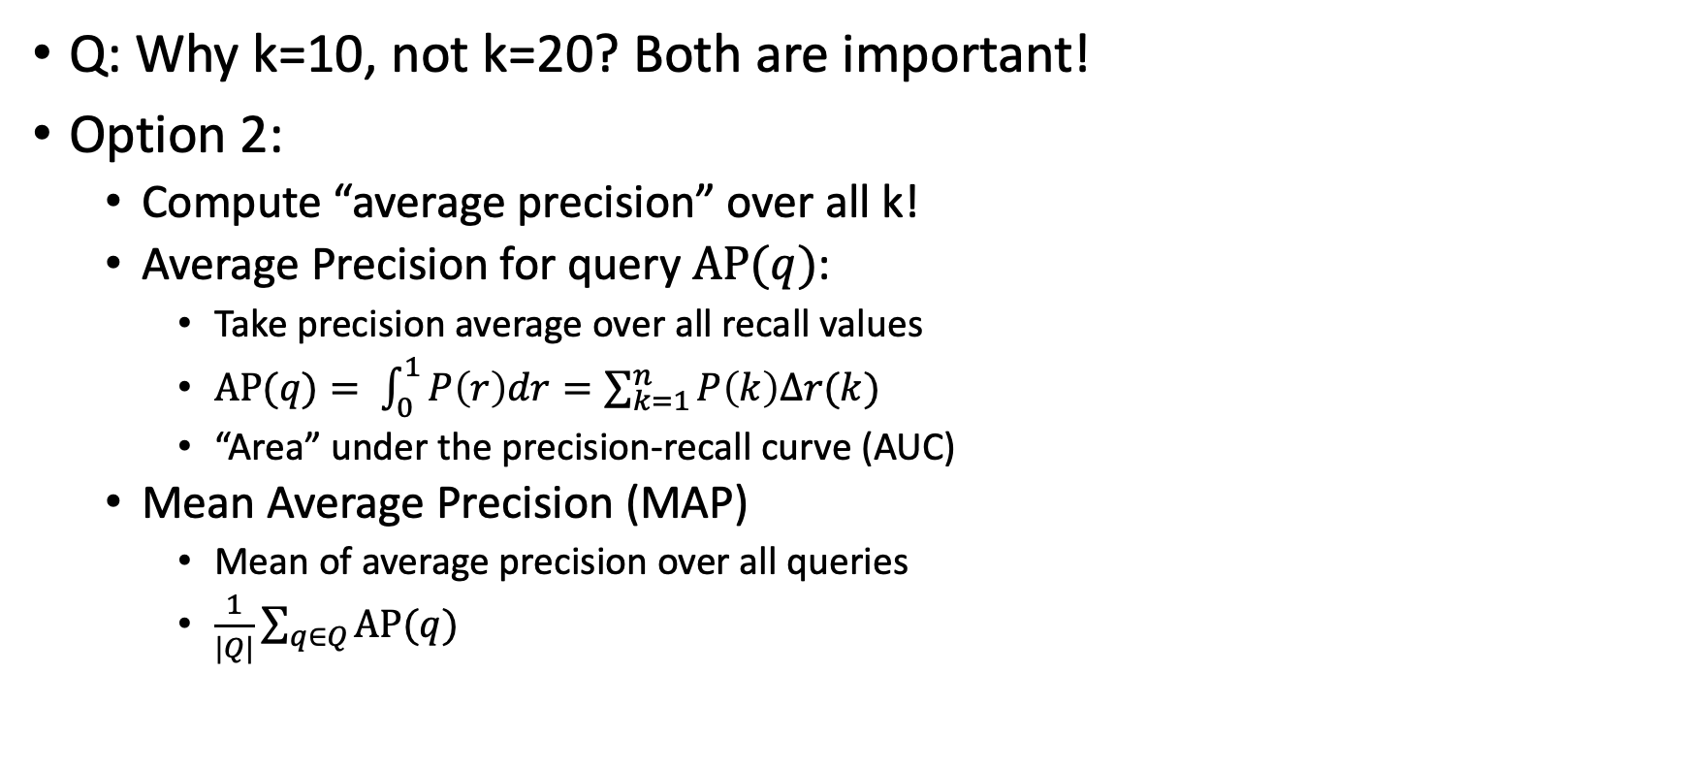
Evaluation of Ranking Model
Q: Why k=10, not k=20? Both are important!
Option 2:
  Compute “average precision” over all k!
  Average Precision for query $AP(q)$:
    Take precision average over all recall values
    $AP(q)= \int_{0}^{1}{P\left(r\right)dr=\sum_{k=1}^{n}{P\left(k\right)Δr(k)}}$
    “Area” under the precision-recall curve (AUC)
  Mean Average Precision (MAP)
    Mean of average precision over all queries
    $\frac{1}{|Q|}\sum_{q∈Q}{AP(q)}$

Slide 7
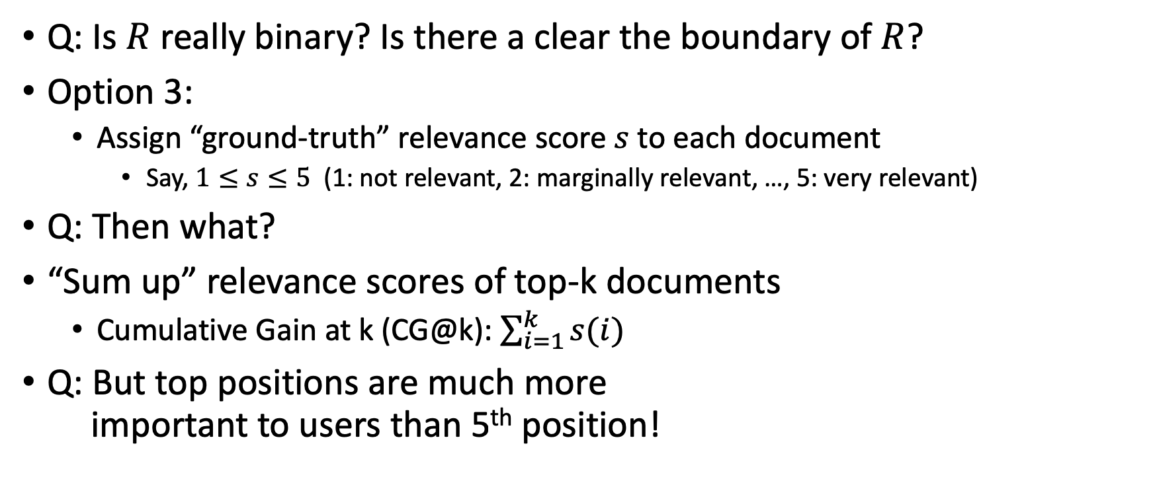
Evaluation of Ranking Model
Q: Is $R$ really binary? Is there a clear the boundary of $R$?
Option 3:
  Assign “ground-truth” relevance score $s$ to each document
    Say, $1≤s≤5$ (1: not relevant, 2: marginally relevant, …, 5: very relevant)
Q: Then what?
“Sum up” relevance scores of top-k documents
  Cumulative Gain at k (CG@k): $\sum_{i=1}^{k}{s(i)}$
Q: But top positions are much more
important to users than 5th position!
C: Collection
R
No clear boundary

Slide 8
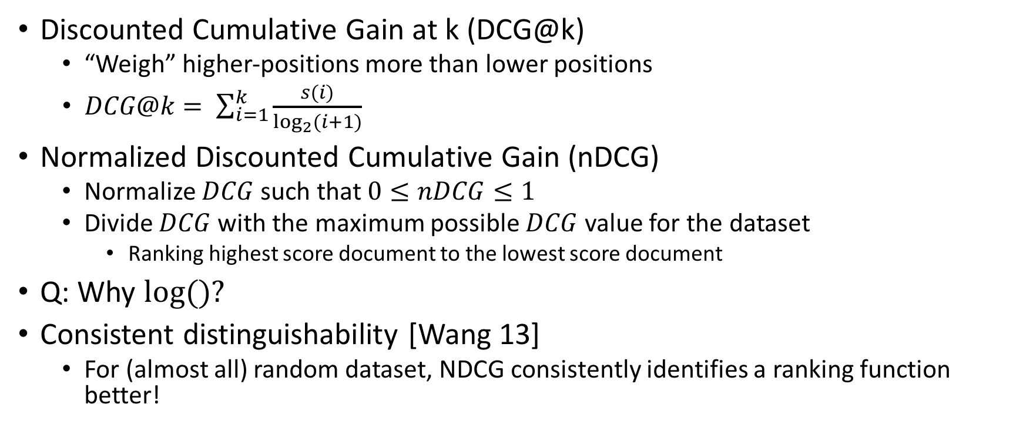
Evaluation of Ranking Model
Discounted Cumulative Gain at k (DCG@k)
  “Weigh” higher-positions more than lower positions
  $DCG@k= \sum_{i=1}^{k}{\frac{s(i)}{\log_{2}⁡(i+1)}}$
Normalized Discounted Cumulative Gain (nDCG)
  Normalize $DCG$ such that $0≤nDCG≤1$
  Divide $DCG$ with the maximum possible $DCG$ value for the dataset
    Ranking highest score document to the lowest score document
Q: Why $log⁡()?$
Consistent distinguishability [Wang 13]
  For (almost all) random dataset, NDCG consistently identifies a ranking function better!

Slide 9
References
[Wang 13] A Theoretical Analysis of Normalized Discounted Cumulative Gain (NDCG) Ranking Measures by Y. Wang et al

